Slide 1
BTECH 451
Final Seminar idphoto.co.nz
Suzzie Yang
Academic supervisor: Xinfeng Ye
Industry supervisor: Paul Young

Slide 2
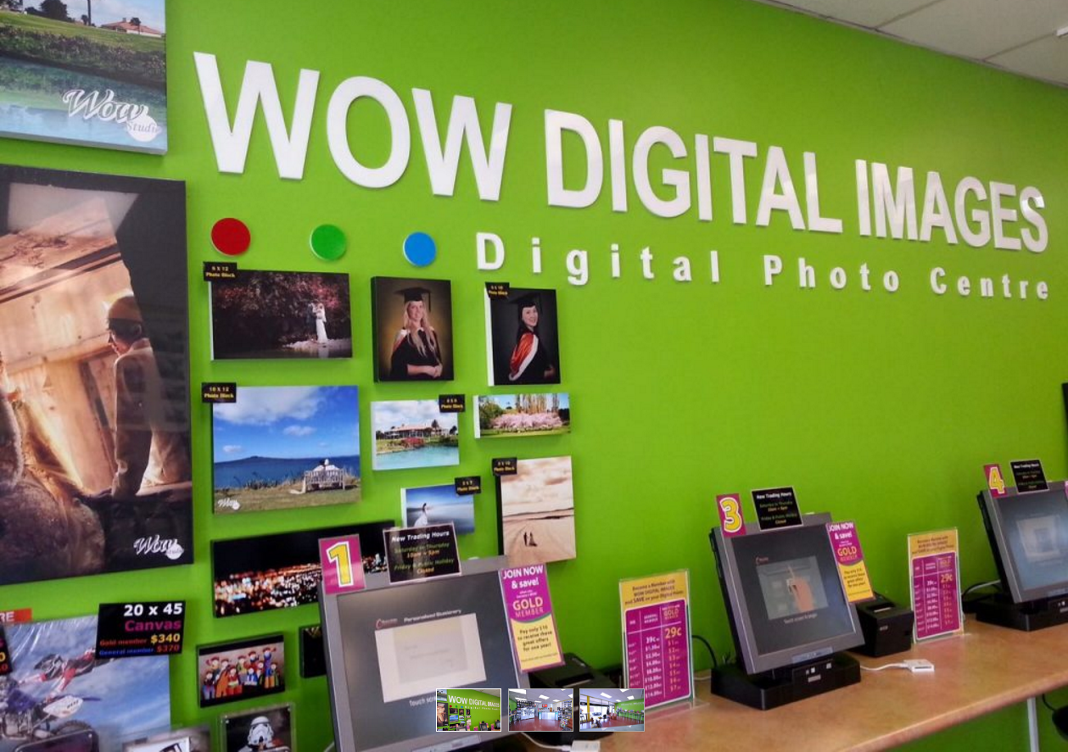
Company-Wow Digital Image
A retail store that offers photo taking and printing services
20 years of business and photo handling experience
Close down retail shop and promote their online servicing website
Notes:
Before going into detail about my project I want to briefly talk about the company. The company is a retail store called Wow Digital Image that started in 1996. They offer photo taking and printing services. Recent years the number of people visiting photo labs for photo print outs has decreased due to the convenience of storing pictures online and digitally, as a result the passport photo and studio photo taking have become the main services for the company.

Slide 3
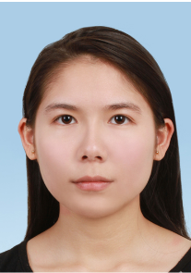
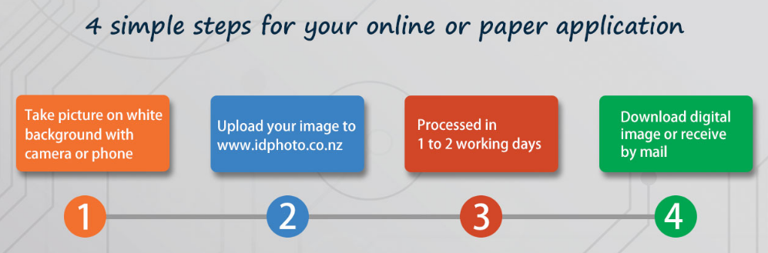
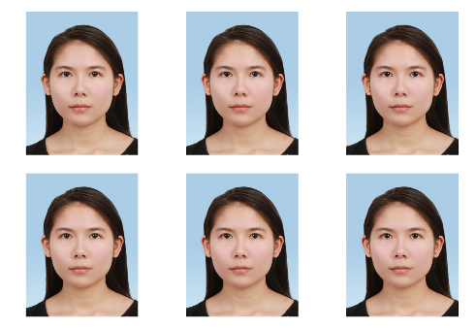
The Project-idphoto.co.nz
Transferring the company’s passport photo service online
A website platform for customer to obtain standard passport photos
Notes:
The project is called idphoto.co.nz and the idea was established following the introduction of online passport renewal service. The service came out in late 2012 other New Zealand formal applications have also started processing their applications online. The project aim is to create a website platform for customers to obtain their passport photos that meet the New Zealand passport standard through our website. Our website allow our customers to obtain both the digital photo and physical photo print out through their registered account. Bringing our passport photo service online provides low cost, convenient service and also target customers nationwide. The website scales very well with the current trend of online processing applications in New Zealand. The main challenge for this project would be how to market the website.
In late 2012 the government service for renewing passport online was announced and soon after that the company thus established the project idea for developing idphoto.co.nz.

Slide 4
Rationales of idphoto.co.nz
Scales very well with New Zealand’s online passport application
Expending local business nationwide
Offer a more convenient and low cost way to obtain passport photos
Capable of replacing existing passport photo services
Notes:
The company team previously worked on a prototype for idphoto however the front-end design was not user friendly and lake of consistency. The majority of the website database was already established and I was given the task to redesign the front-end and also integrating the back-end design. For my front-end design I am working with html, css and jquery and also using bootstrap frameworks to aid my implementation. Later in the semester I will be working on the back-end design with PHP. Improving the already existing database and implement new features. Security measures will be looked into and implemented into the website once both front-end and back-end design are completed. Post-project maintenance is also important as well.

Slide 5
The problem
Back end: PHP vs ASP.Net
Improve efficiency and security
Auto facial recognition system
Encryption with user’s uploaded photo
Redesign user interface
Html5/css/javascript/jquery
demo

Slide 6
Comparison PHP vs ASP.Net
Factors taken into account:
Traffic load
Efficiency-query execution, on load, upload speed
Easy to learn
Security
Cost

Slide 7
PHP vs ASP.NET
 | PHP | ASP.net
Compatibility | Linux Windows Solaris | Windows *Require extra hardware/software and so higher cost
Cost | Low | Relatively high
Traffic flow handling | Low | High
Processing speed | Even results | Even results
Database management | Fast | Relatively slow
Security | Even results | Even results
Open source | Yes | No
Development time | Differs situationally | Fast
Notes:
http://www.codeproject.com/Articles/102854/PHP-and-ASP-NET-A-Feature-List

Slide 8
Image encryption scheme Chaos-based encryption
A protection of the customer’s personal photo
Attacks:
Brute-force work our of the encryption key sequence
Statistical attack
Process:
Apply randomised key sequence to image pixel -> cipher image
Apply permutation to cipher image -> encrypted image
Notes:
2012

Slide 9
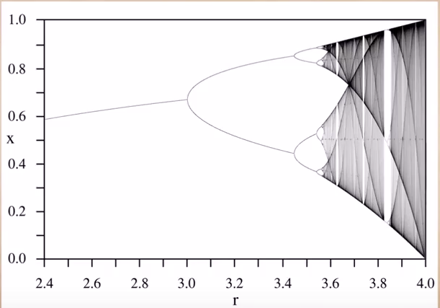
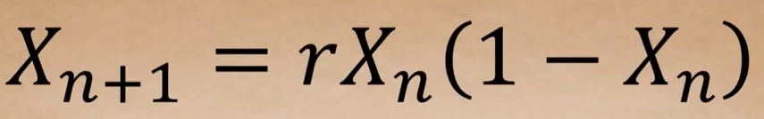
Logistic map
Logistic maps has higher key space
Produce random sequence to apply to the image pixels
Bigger the r , broader the range of randomised true number
Brute-force attack doesn’t stand a chance

Slide 10
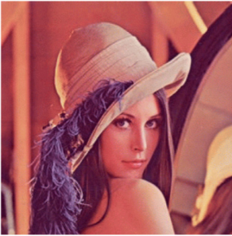
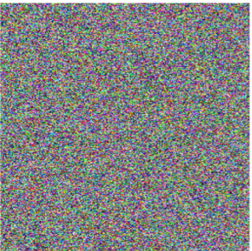
Permutation
Image pixels that are adjacent to each other are highly correlated
Permutation after ciphered image between adjacent pixels decrease the correlation and so prevent statistical attack

Slide 11
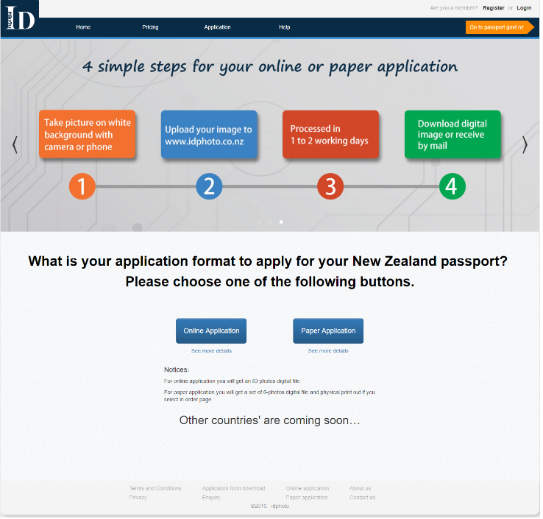
The published website
Demo

Slide 12
Thank you Questions?

